Slide 1
How To: Use Self Service
Keene State College

Slide 2
Table of Contents
How To Get to Self Service……………………………………………………………………….2
View Your GPA, Progress, and Degree Requirements……………………………………….....3
View your GPA, Degree, Major(s), Minor(s), Year you started
View Total courses progress, total credits, and course requirements
Search For Courses………………………………………………………………………………..6
Search for courses by each required section and add them to your schedule
View Your Schedule…………………………………………………………………………......10
View your current schedule and past semesters
View past grades, your advisor, and register for courses here
Other…………………………………………………………………………………………......14
How you can get to financial aid, your transcript, and many other important items

Slide 3
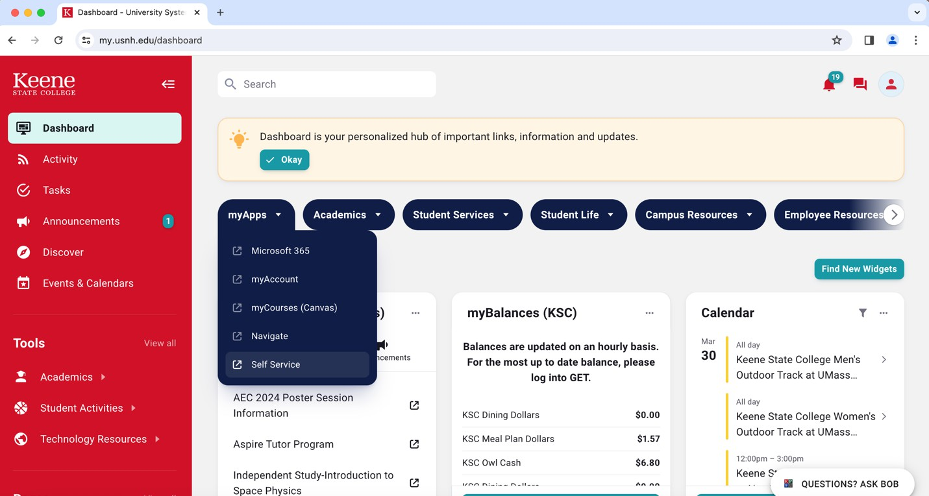
How to Get to Self Service
Go to: https://my.usnh.edu/dashboard
Under “myApps”, click “Self Service”

Slide 4
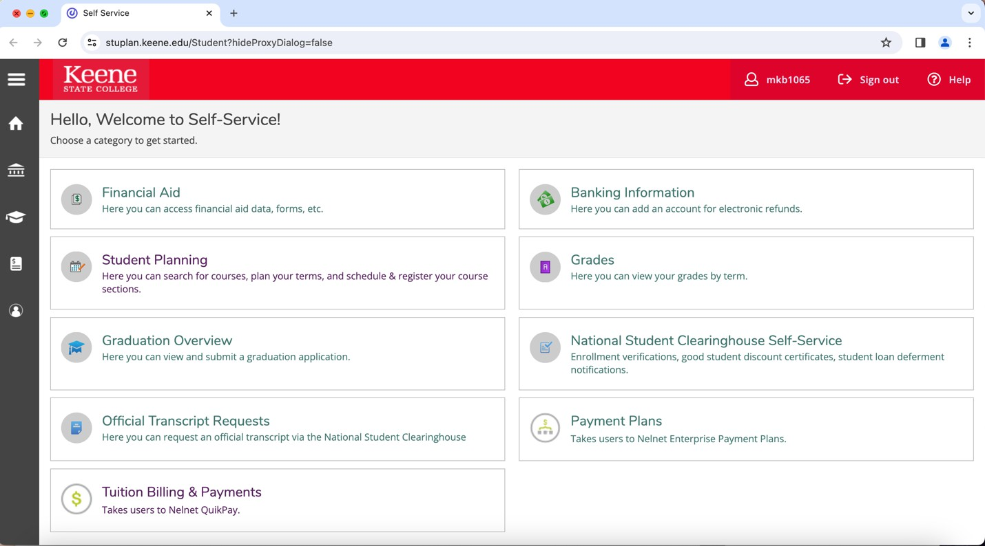
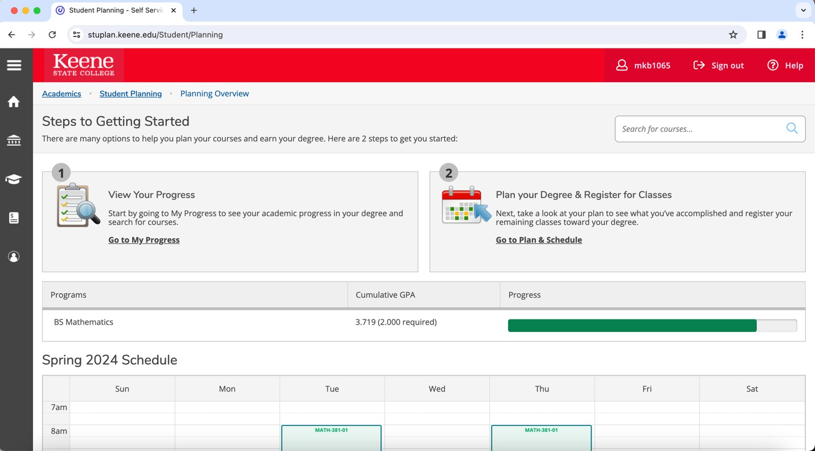
View Your GPA, Progress, and Degree Requirements:
Go to Student Planning
If you want to view you academic and course progress, click on “Go to My Progress”

Slide 5
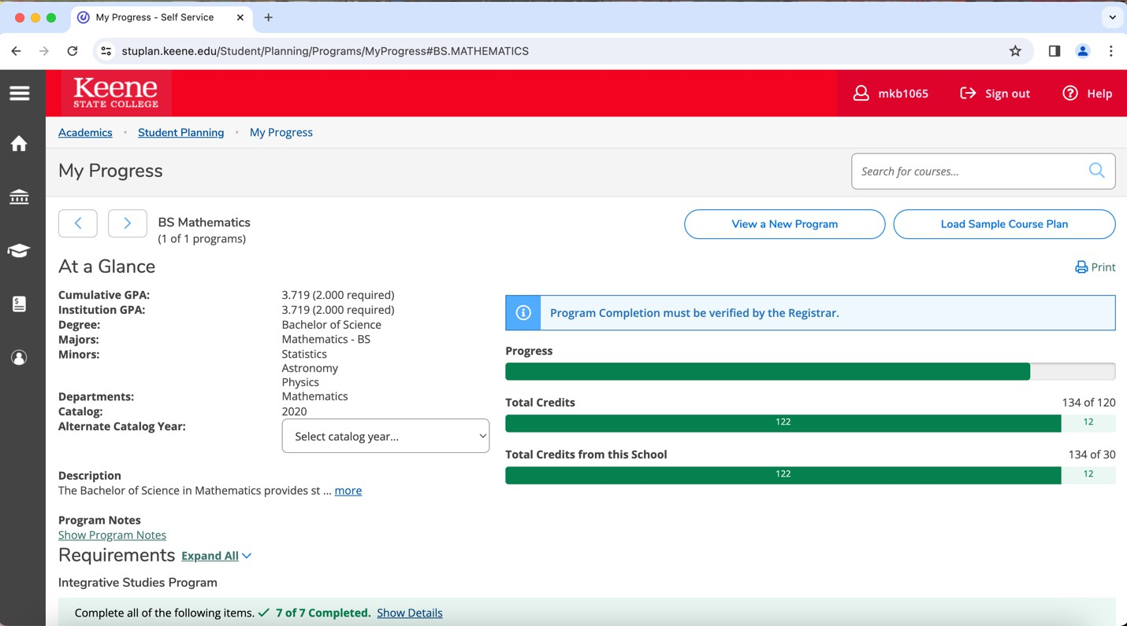
At the top-left corner of the page, you can view your GPA, Degree, Major(s), Minor(s), and Year you started
On the top-right, you can view your total course progress and total credits

Slide 6
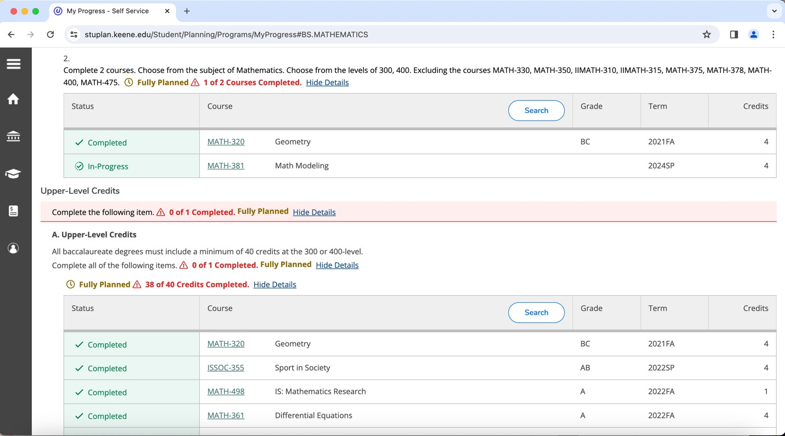
As you scroll down, you can view the requirements for electives and your major program in order to graduate
  When these required courses/sections are completed it becomes green, when they
are planned in your schedule it becomes yellow, and when they still need to be completed they are red
  This shows your progress for each section of required courses
The required main sections include: Integrative Studies Program, Your Major Program, Upper-Level Credits, Your Minors Program (if any), Other Courses
  There are sub-sections within these that are required as well

Slide 7
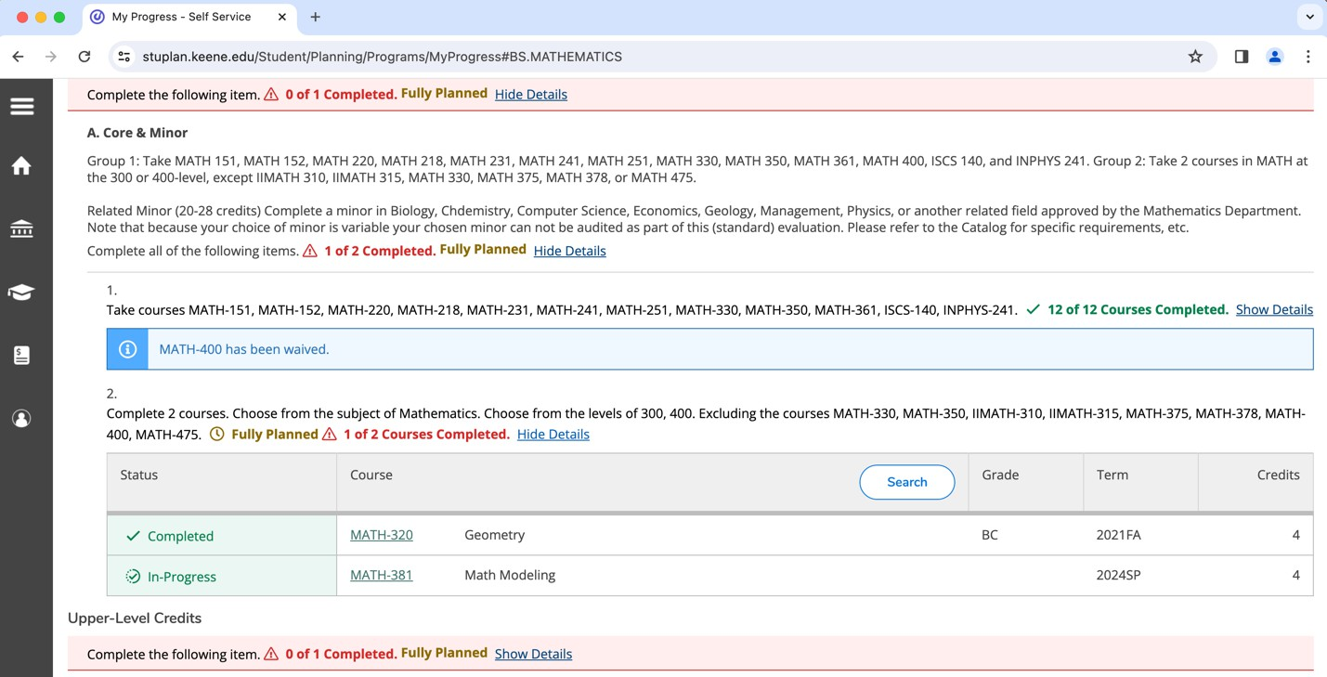
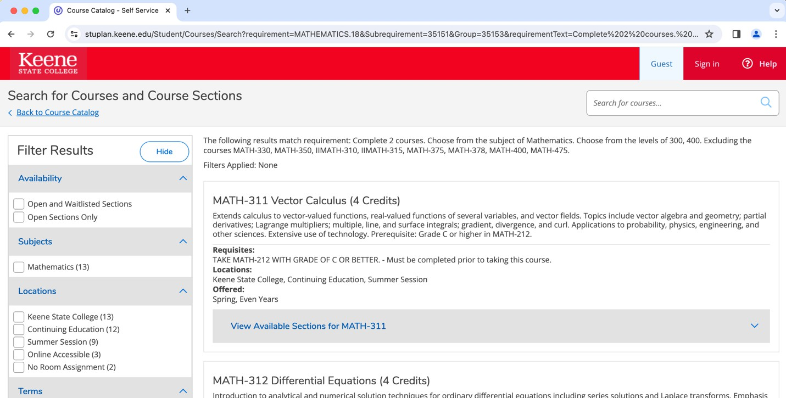
Search for Courses:
Still under “My Progress”, there are a few different ways to search for courses:
1) Under each section of required courses, if you are looking for a course that fits that requirement, then click the search bar at the top of that section
This gives you courses that would fit this specific requirement
2) If looking for a specific course or subject, there is a search bar at the top-right of the page that says “search for courses”

Slide 8
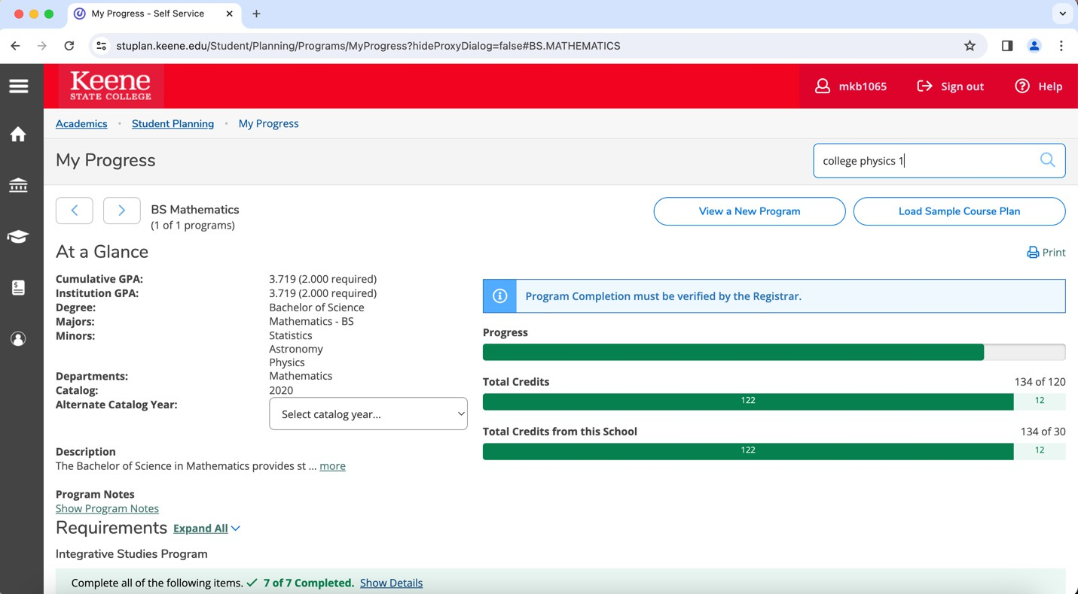
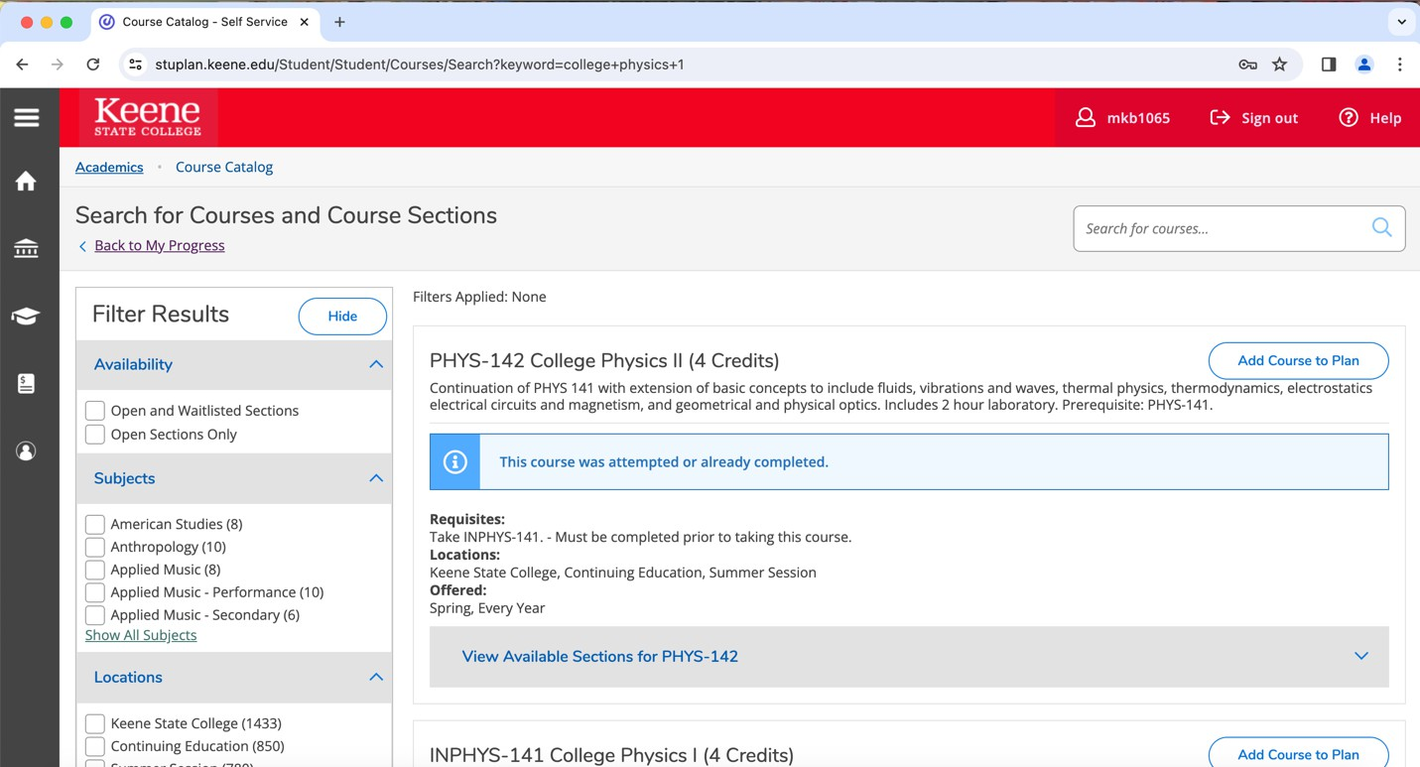
This search will give you that course and courses similar to it
It will show if you have already taken the course or if it is in progress
On the left-hand side, you can filter through courses by selecting a specific subject, location, term, day of week, time of day, instructor, level, and online vs. in-person

Slide 9
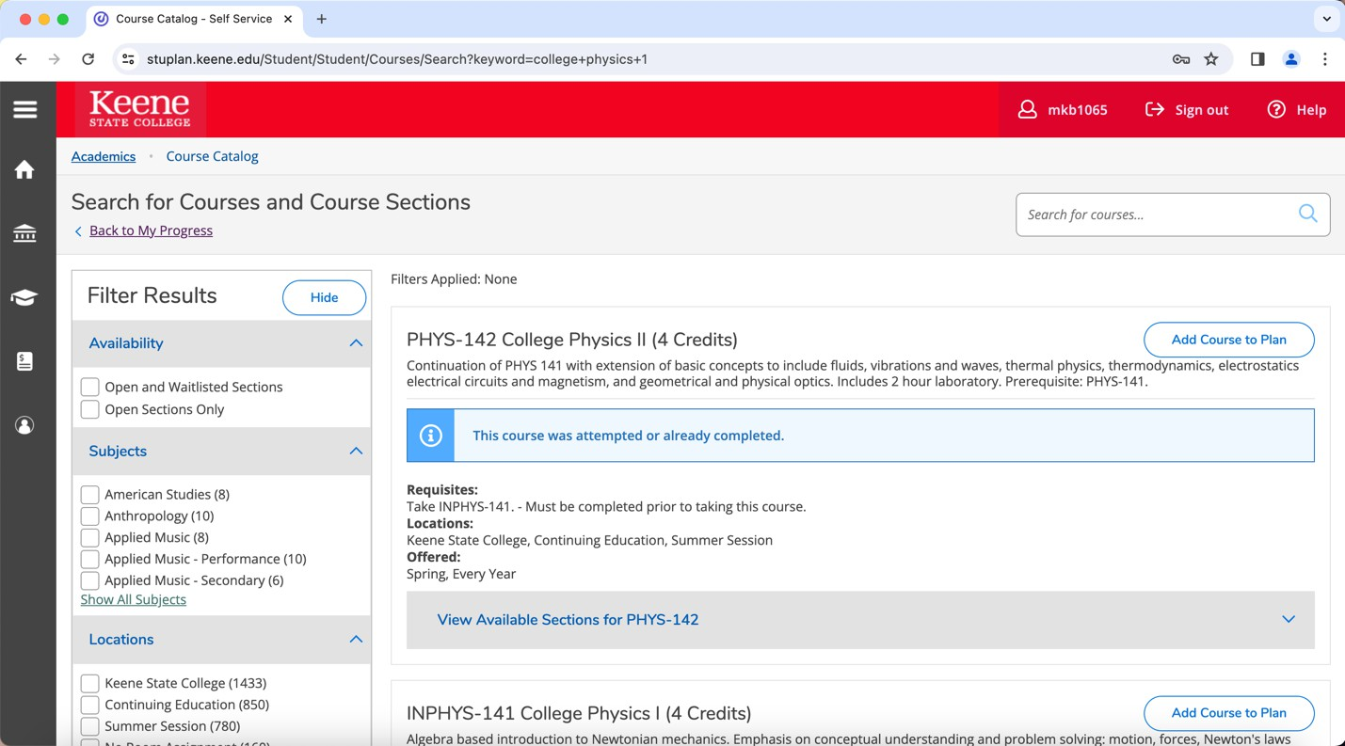
Under the specific course, you can click “View Available Sections” to see when/if the course is being offered
  You can also view a description of the course and any prerequisites needed
Here you can view the available term, time, place, instructor, and available seats
Here you can click “Add Section to Schedule” to plan this course

Slide 10
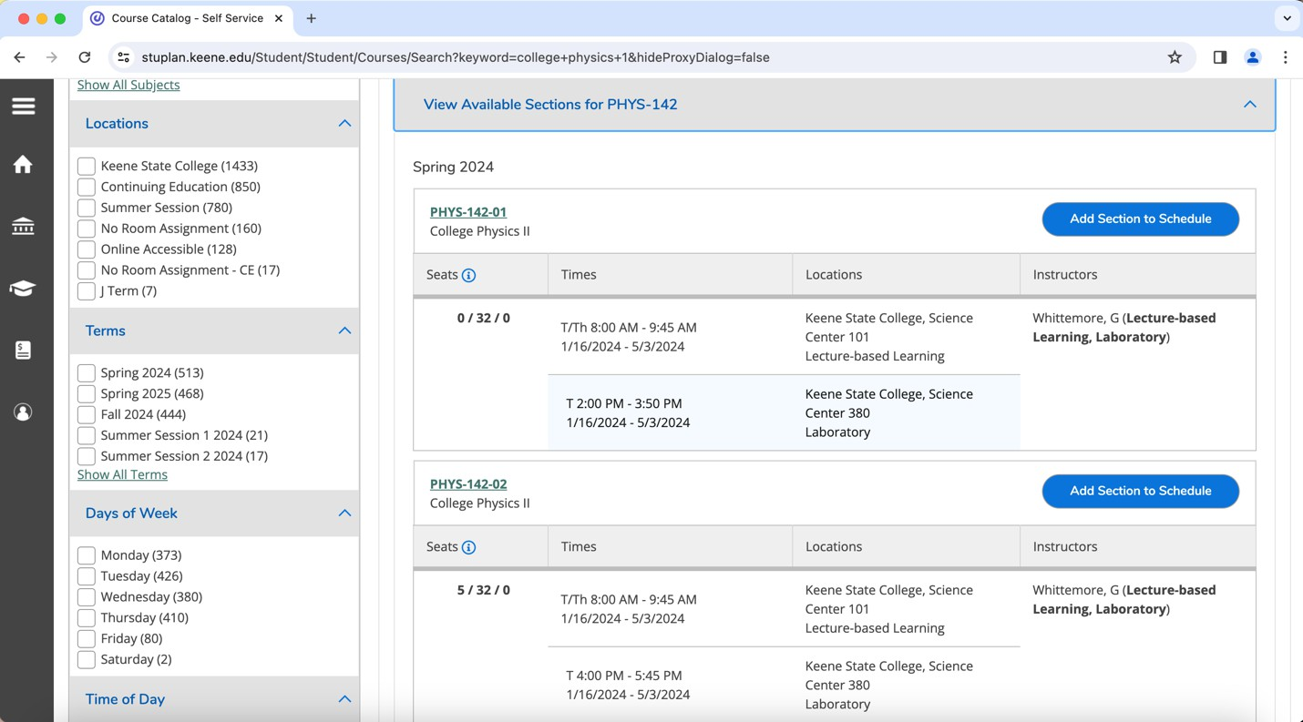

Slide 11
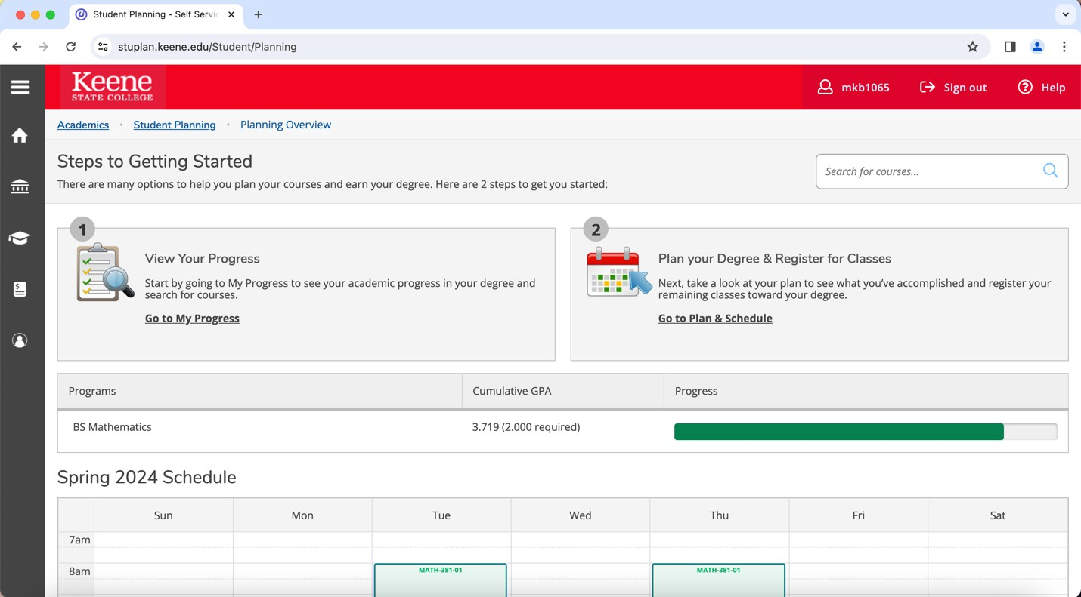
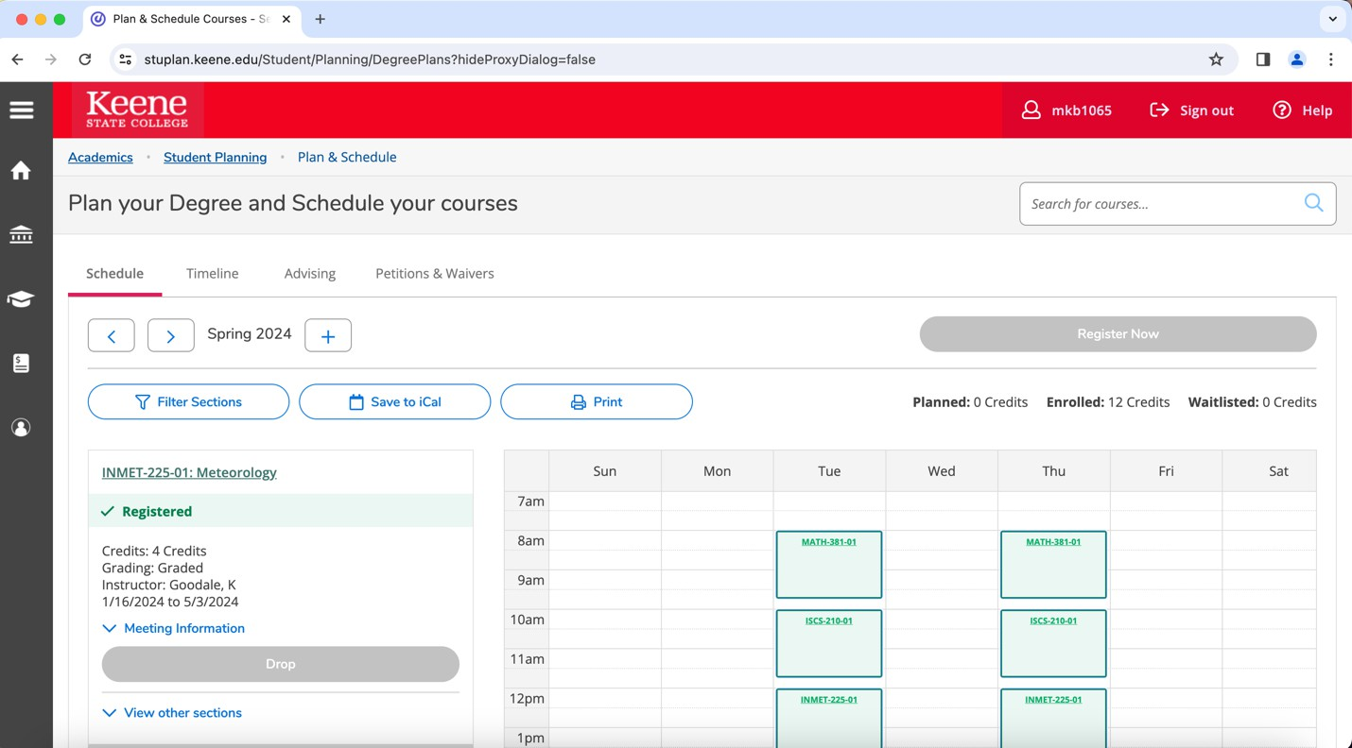
View Your Schedule:
While under Student Planning, click “Go to Plan & Schedule” if you want to view your courses and schedule
Here you can view your schedule for your current semester, past semesters, and what you have planned for future semesters

Slide 12
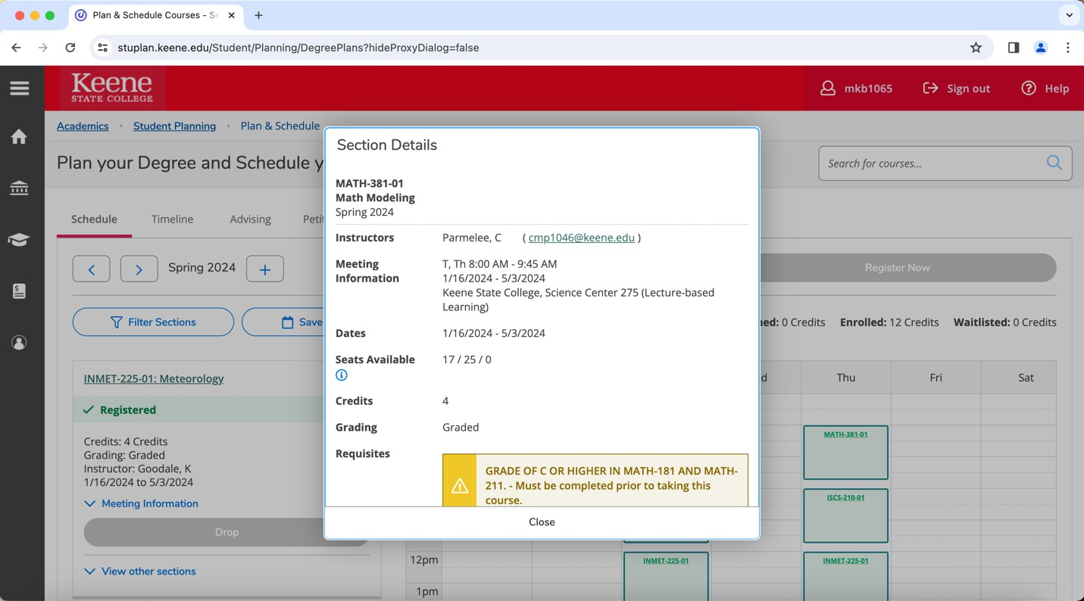
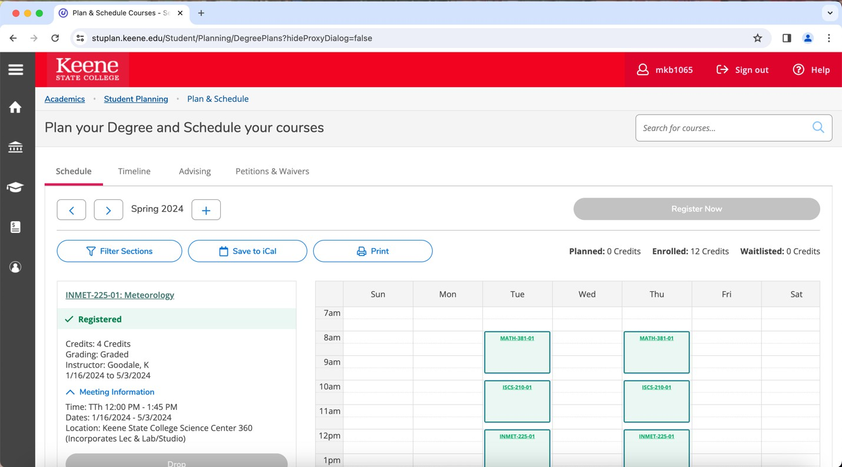
If you click on one of your courses, you can see a description of the course, meeting time, the professor, meeting place, and how many credits it is
When it is time for registration, click “Register Now” at the top right (This is only allowed when it is during your registration period)

Slide 13
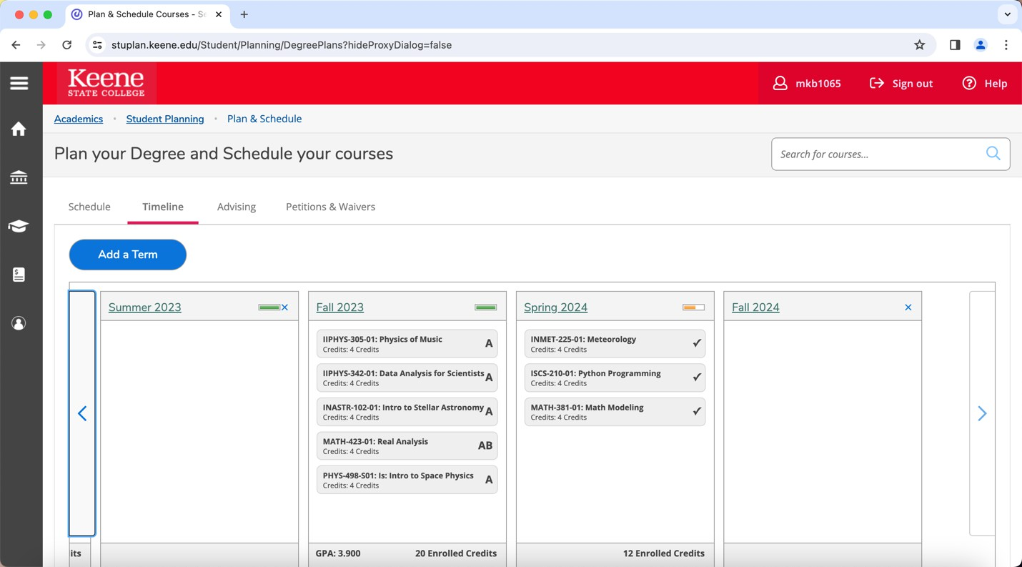
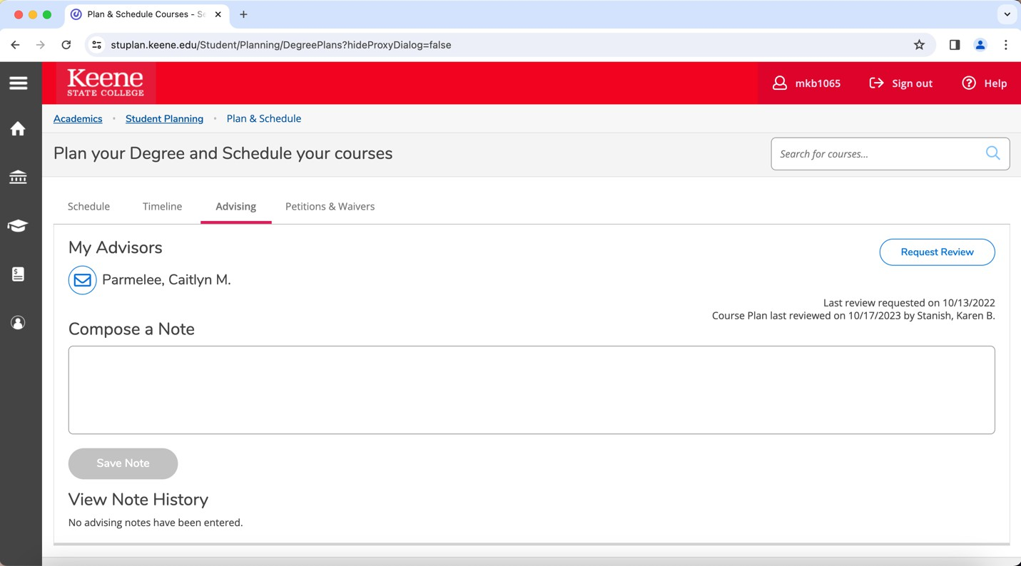
If you click “Timeline”, you can see the timeline of your semesters here at Keene State along with the grades for each course, and GPA for that semester
If you click “Advising”, you can see who your advisor is and have them view and approve your planned schedule before registration time
If you click “Petitions & Waivers”, you can view any courses that have been waived

Slide 14
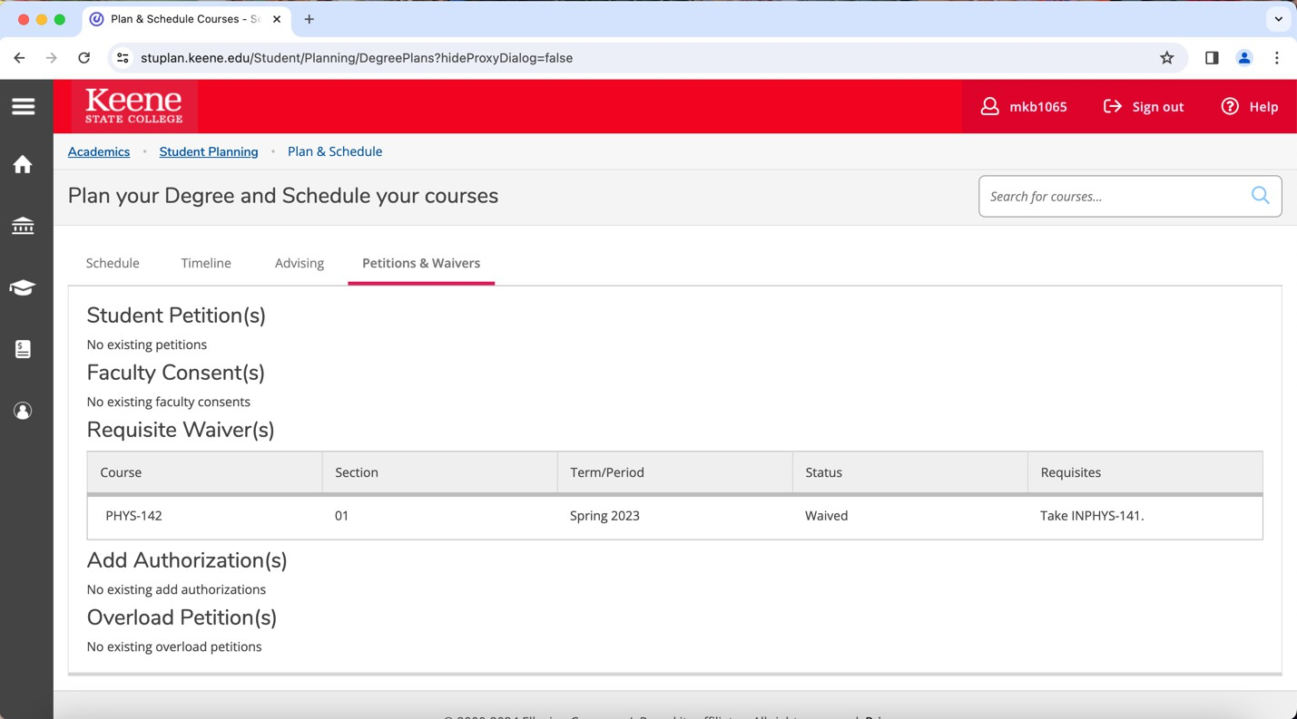
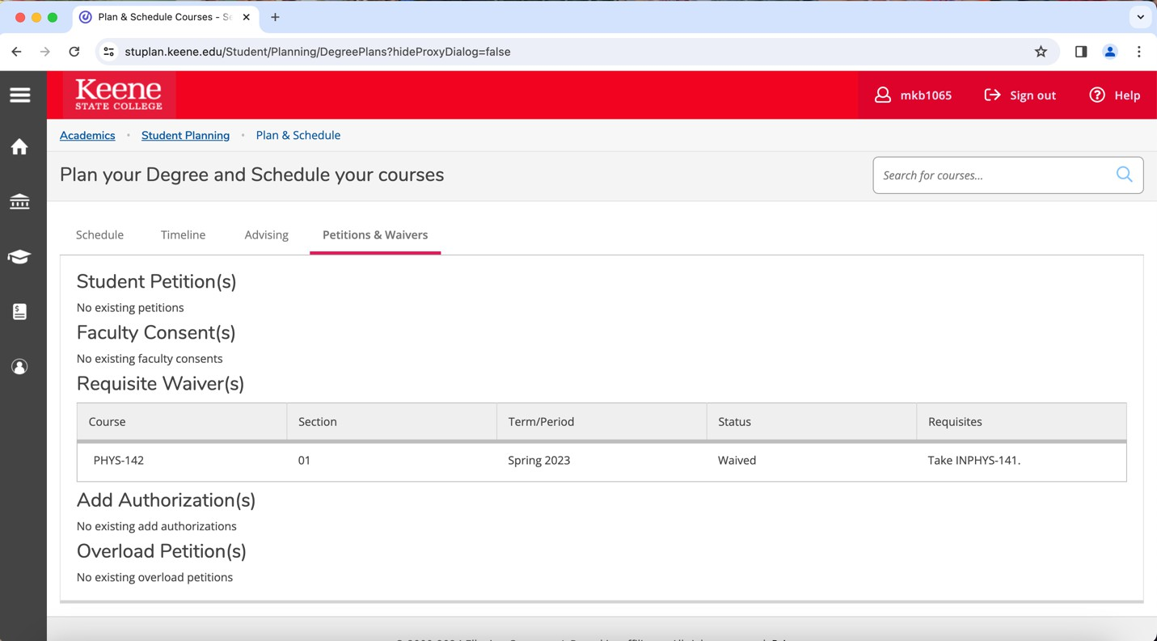
You can also search for courses here by using the search bar at the top-right of the page that says “Search for courses…”

Slide 15
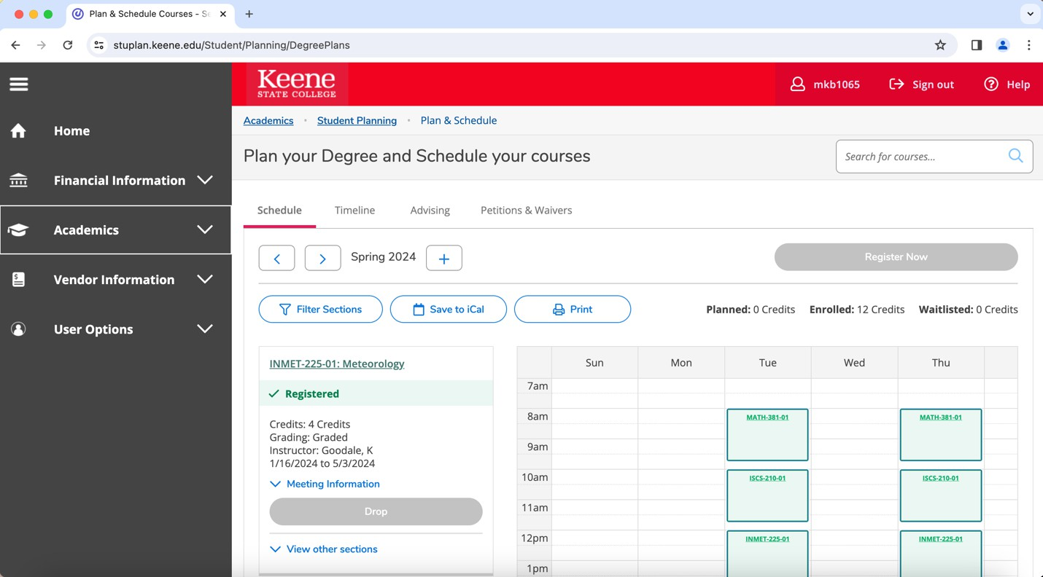
On the left side of the page, click the 3 lines to look at other information and resources!

